Slide 1

Predicting Life Expectancy
Group 50
GROUP 50

Slide 2
Introduction: Project aims
Find the best model for predicting
life expectancy at birth
Study the average life expectancy
across various continents

Slide 3
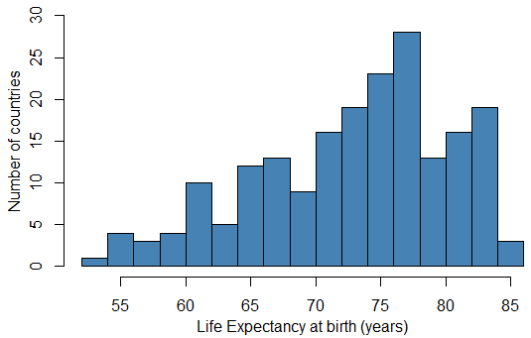
Preliminary Analysis of the Dataset
Dataset overview - World Development Indicators:
Contains indicators for 217 countries
Each country has 26 different measurements
Histogram of Life Expectancy
Key facts:
Overall, life expectancy has a mean of 72.9 years
Lowest value: Central African Republic – 53 years
Highest value: Hong King, China – 85 years

Slide 4
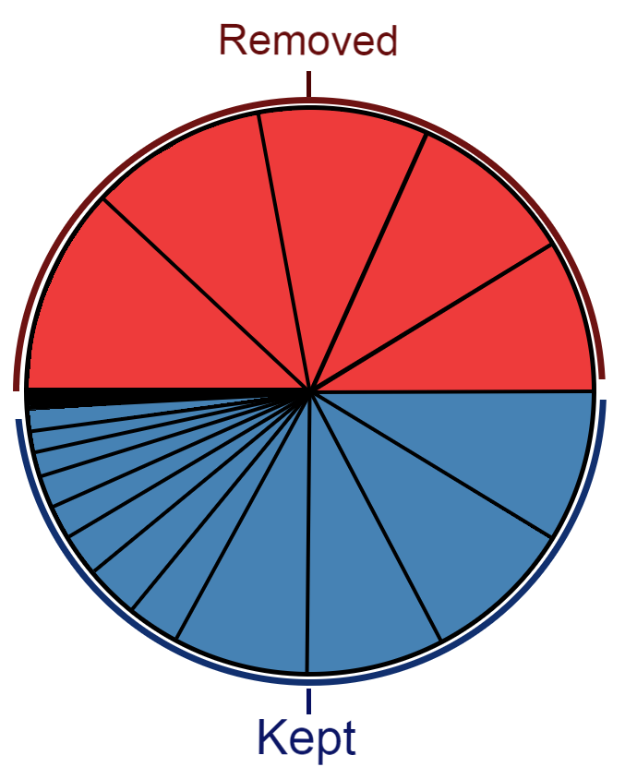
Dealing with missing values
Assumption: The data are missing at random
Key facts:
Number of missing values
per column visualized
Using variables with many missing values should be avoided
35% of the entries are missing (1981 entries out of 5642)
50% of the missing data comes from five columns,
which were then removed
195
192
181
217
179
Method – Multiple imputation:
127
Five complete copies of the dataset were constructed from the distribution of the observed data
104
96
99

Slide 5
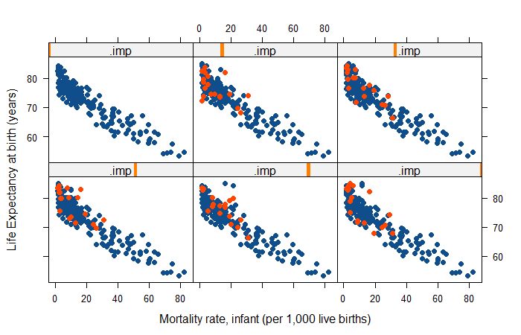
Dealing with missing values
Imputed data plotted against the rest
of the observations for the five datasets
Examining multiple plots for the imputed datasets suggests that the imputed data follow the distribution of the original data.
Different combinations of variables were explored, most of them showed similar characteristics.
Imputed
Observed

Slide 6
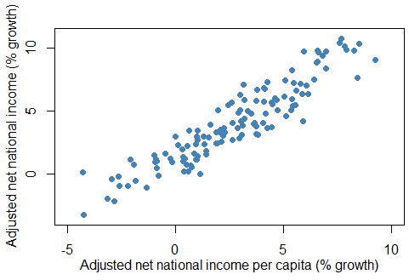
Dealing with collinearity
Assumption: Linear relationship between variables
Key facts:
Scatterplot for two
highly correlated variables
Highly correlated predictor variables are harmful for the model
The given data has several correlated variables (example in the figure)
25% of the predictor variables have a VIF greater than 5.
Remark: VIF if a measure of correlation.
Having variables with values over 5 is concerning.

Slide 7
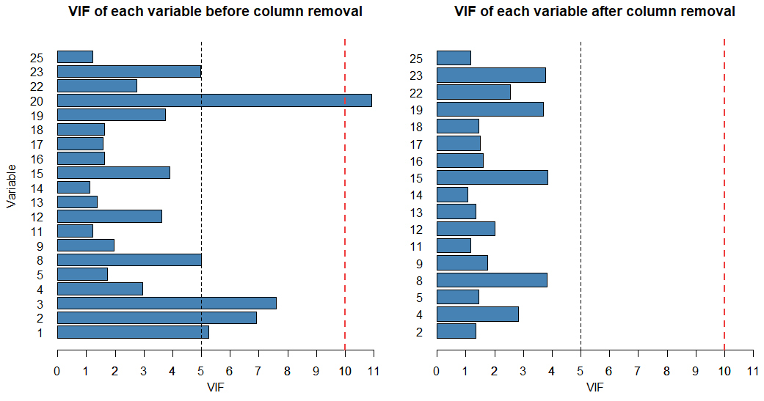
Dealing with collinearity
The effect of deleting a small set of variables of the overall VIF
Method:
Variables were removed one by one based on:
the pairwise correlation
the VIF value of each variable
Goal:
Maximum VIF lower than 5
Result:
Three variables were removed
Maximum VIF is 3.8

Slide 8
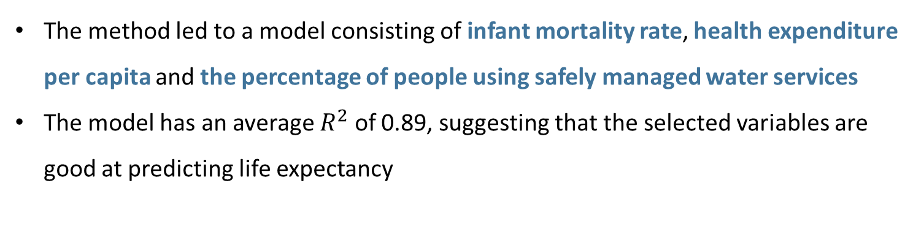
Finding the best model
Assumption: Linear relationship between variables
Method:
Stepwise regression was used for each imputed dataset
The most frequently selected variables were used to construct the final model
The coefficients were selected by averaging the values for the five fitted models
Result:
The method led to a model consisting of infant mortality rate, health expenditure per capita and the percentage of people using safely managed water services
The model has an average $R^{2}$ of 0.89, suggesting that the selected variables are good at predicting life expectancy

Slide 9
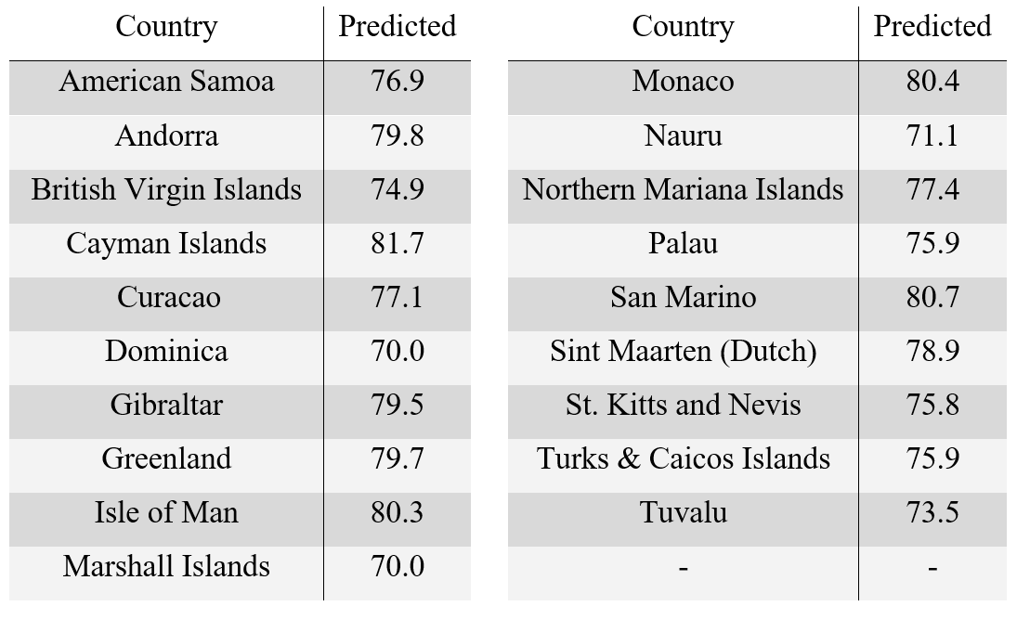
Predicting life expectancy
Method:
The final model was used on each imputed datasets to get five values for each country
The five different values were averaged out to get the final estimate.
Result:
The values are plausible
No obvious outliers
Predicted life expectancy for the countries
where the values were missing

Slide 10
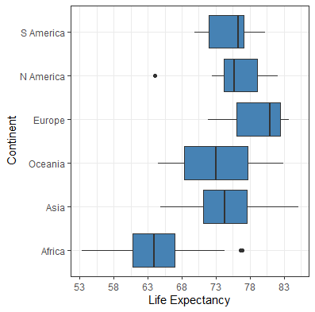
Life expectancy across continents
Key facts:
Life expectancy across continents
The variances of life expectancies are not equal across continents
Method:
The pairwise differences between the means across the continents were investigated using a DTK test
Results:
Life expectancies are the same in Asia, Oceania, South America and North America.
Life expectancies in Europe and Africa are different from all others

Slide 11
Conclusion
Final model contains:
infant mortality rate
health expenditure per capita
percentage of people using safely managed water services
Key takeaways:
The selected variables are good at predicting life expectancy
Higher infant mortality rates = Lower life expectancy
Higher health expenditure = Higher life expectancy
Higher focus on clean water = Higher life expectancy
There exists a natural explanation for the effects of the variables on life expectancy
Life expectancy is different across continent

Slide 12
Thank you!
Group 50

